Slide 1
Addressing Edge AI Challenges to scale
Anomaly detection/inference made simple with Eclipse Kura & Kapua

Slide 2




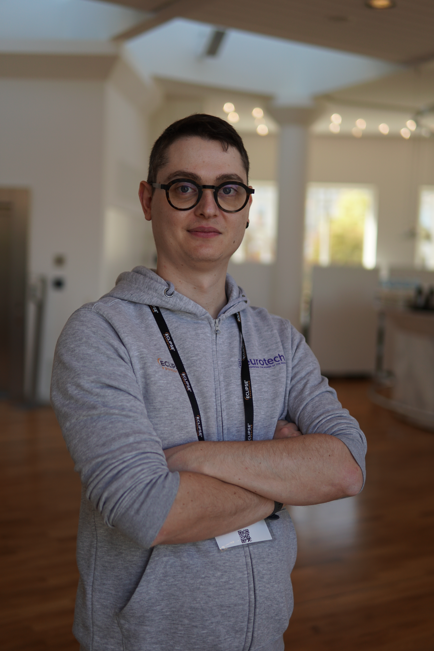

Who are we?
Salvatore Coppola
Senior Engineer @ Eurotech SPA
Gregory Ivo
Engineer @ Eurotech Inc
Simone Fiorani
Engineer @ Eurotech SPA
Mattia Dal Ben
Engineer @ Eurotech SPA

Slide 3

What is a Edge IoT Deployment?

Slide 4
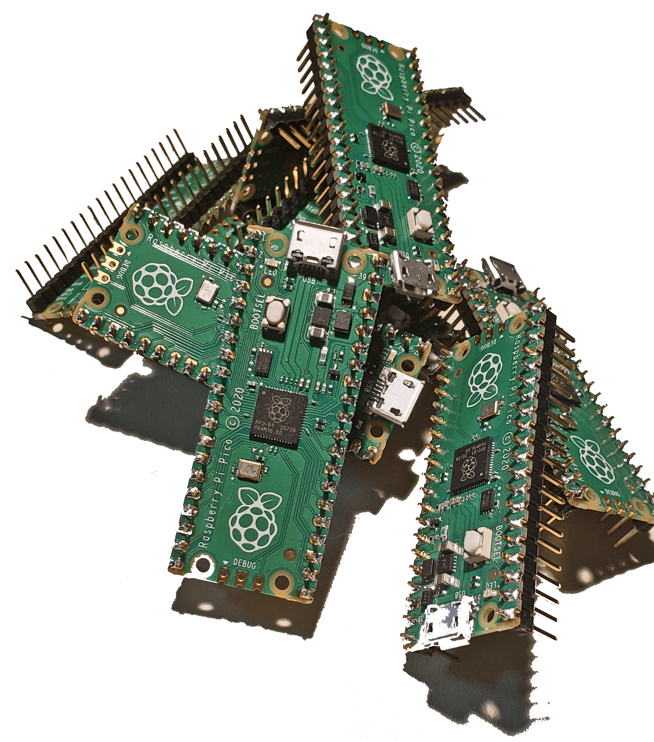
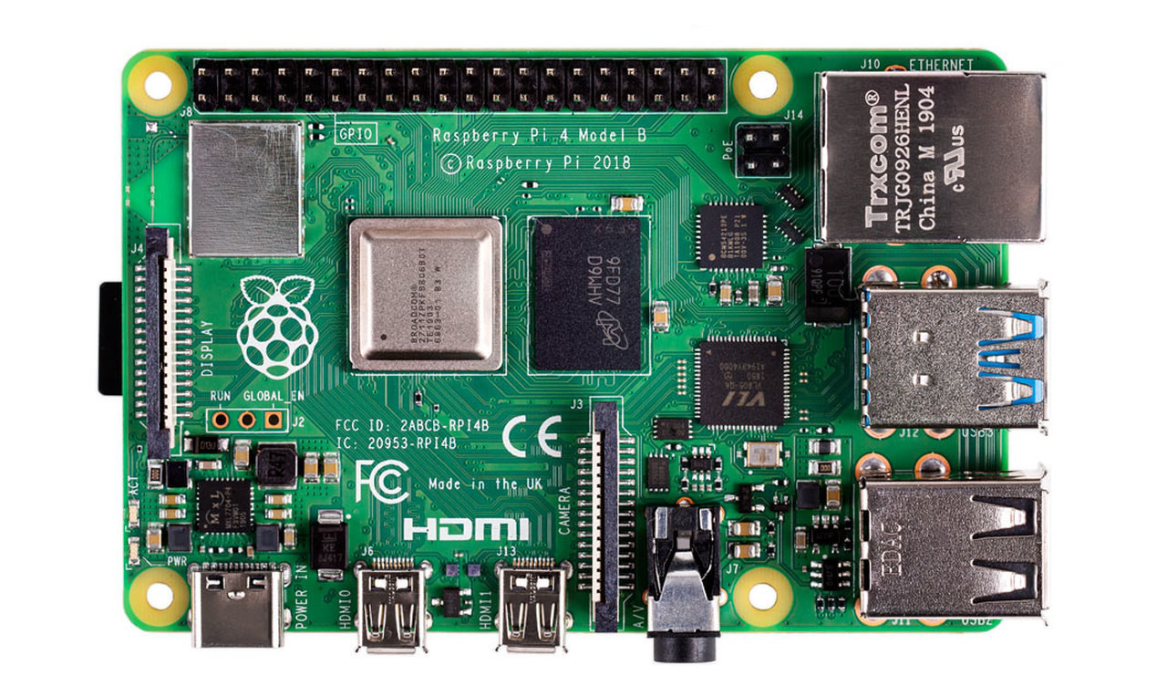
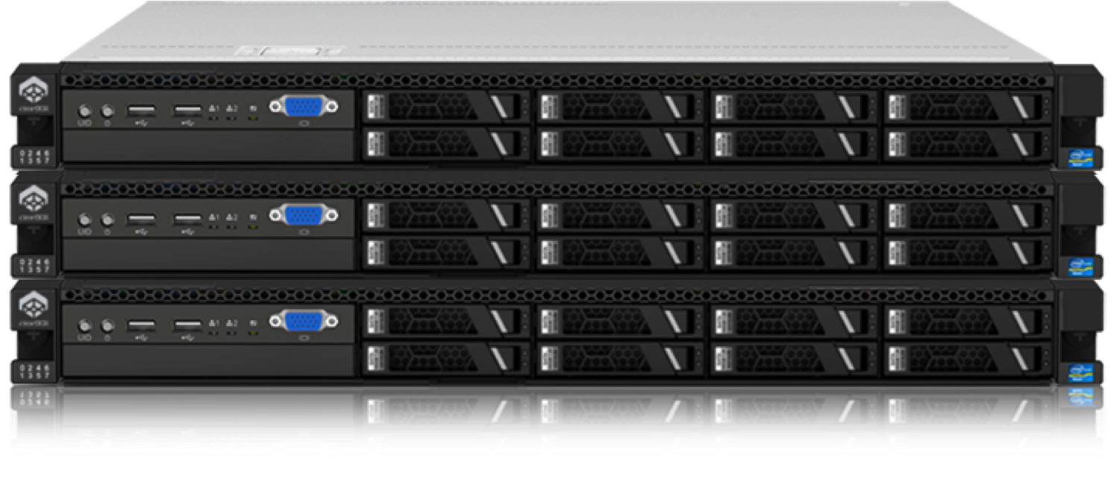
What is an Edge-IoT Deployment?
This Photo by Unknown Author is licensed under CC BY-NC
Notes:
We generally think of systems designed to gather data.
These tiny computers are the left, would be connected to sensors in the field which gather data about the physical world.
This can be Things like temperature sensors, to PLC’s
These tiny computer are then connected to medium sized ‘Edge Computer’. Edge computers act as a gateway between the IoT and the Cloud.
Edge computers, are can be a lot more powerful then IoT computers, and can do things like process and aggregate the data from many Iot devices. They can also decide which data is important to send upwards to the cloud. As you will see today, this only scratches the surface of what is Possible on the edge.
Finally the right we have large powerful data center computers or Cloud computers act as the main aggregation point for all downstream devices. Cloud server can act as both a central point for management, and data access.

Slide 5
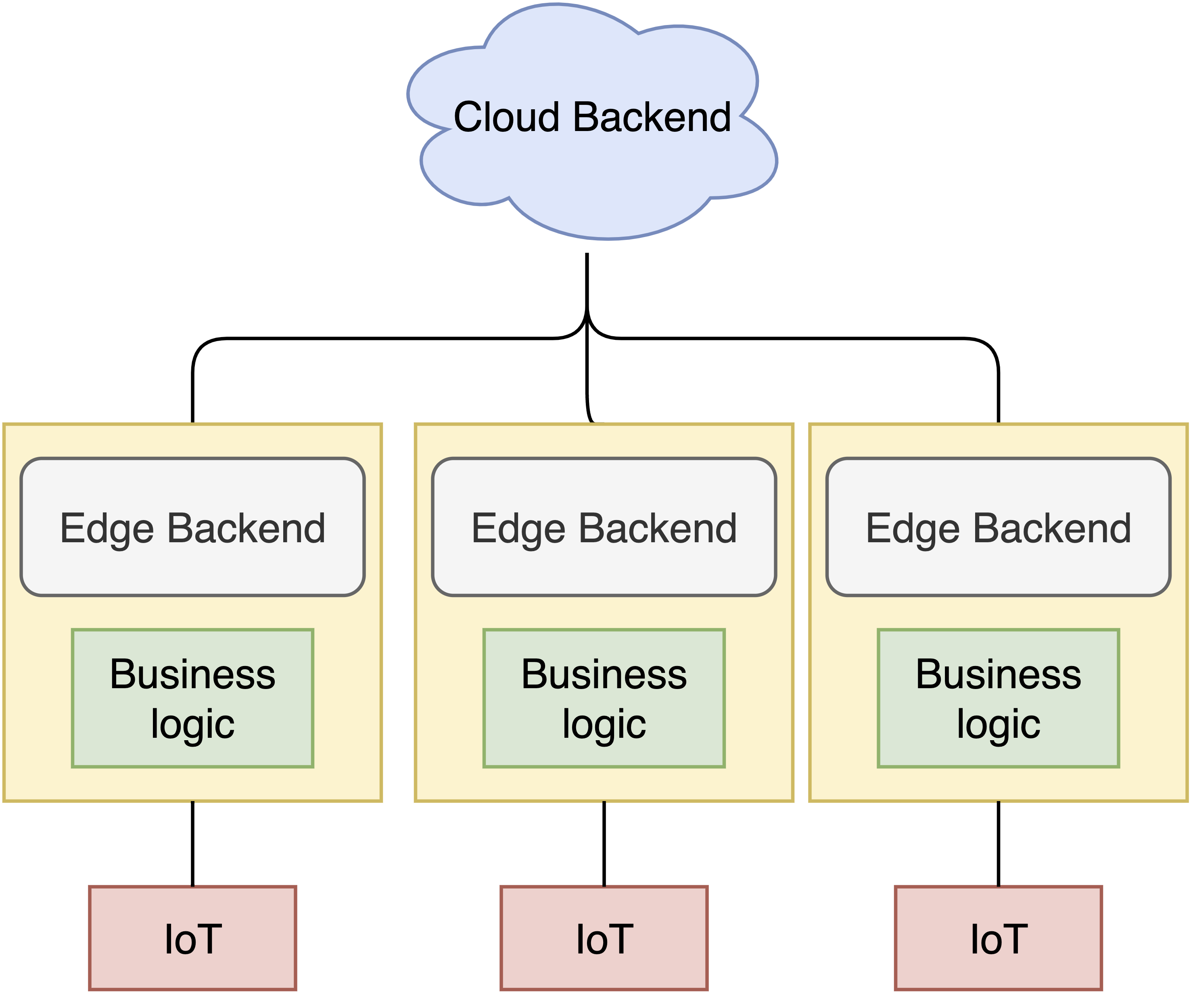
The Basics: A Typical IoT-Edge Deployment

Slide 6
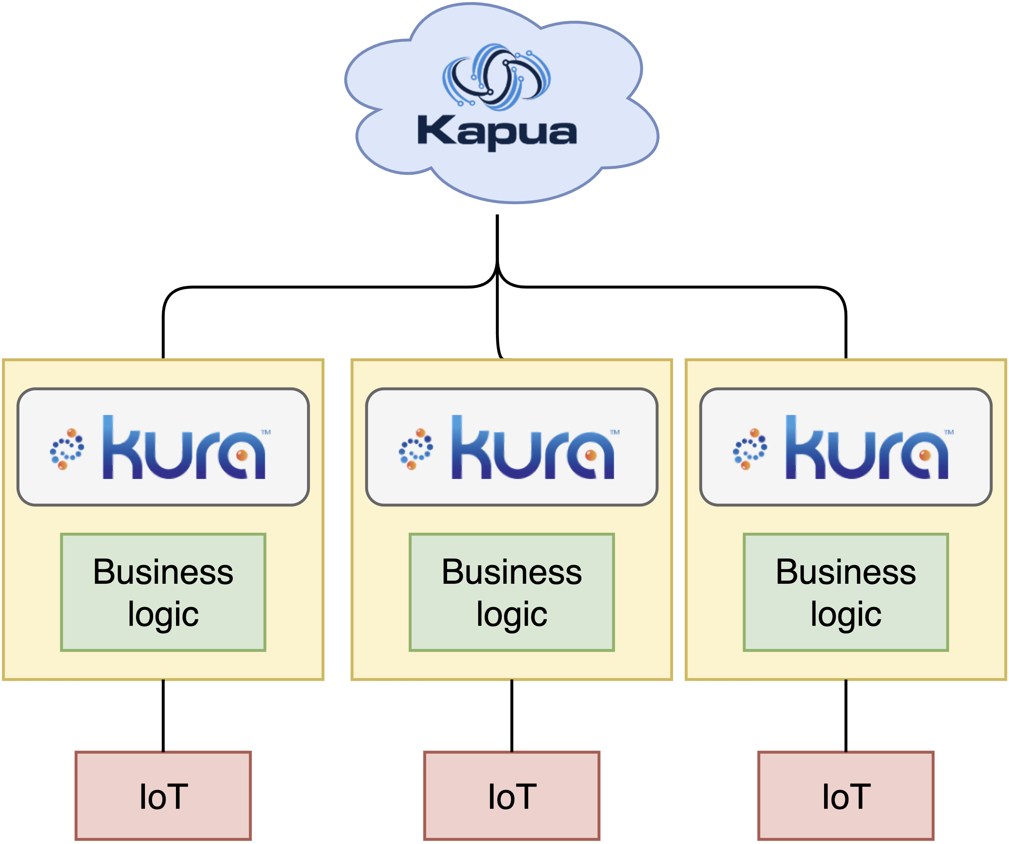
What Eclipse Kura & Eclipse Kapua look like in a deployment

Slide 7

What is
Edge framework that runs on confined devices (i.e. Raspberry Pi)
Kura-Wires allows users to visually program data flows
Orchestrates containers
Sends & Accepts MQTT data streams
Safely stores configurations & secrets
User friendly web accessible UI
Notes:
Eclipse Kura is a software framework that runs on your edge that implements and simplifies the basics needed to get an Edge deployment running. Out of the box, Kura handles communication to Iot devices using various protocols such as MQTT.

Slide 8
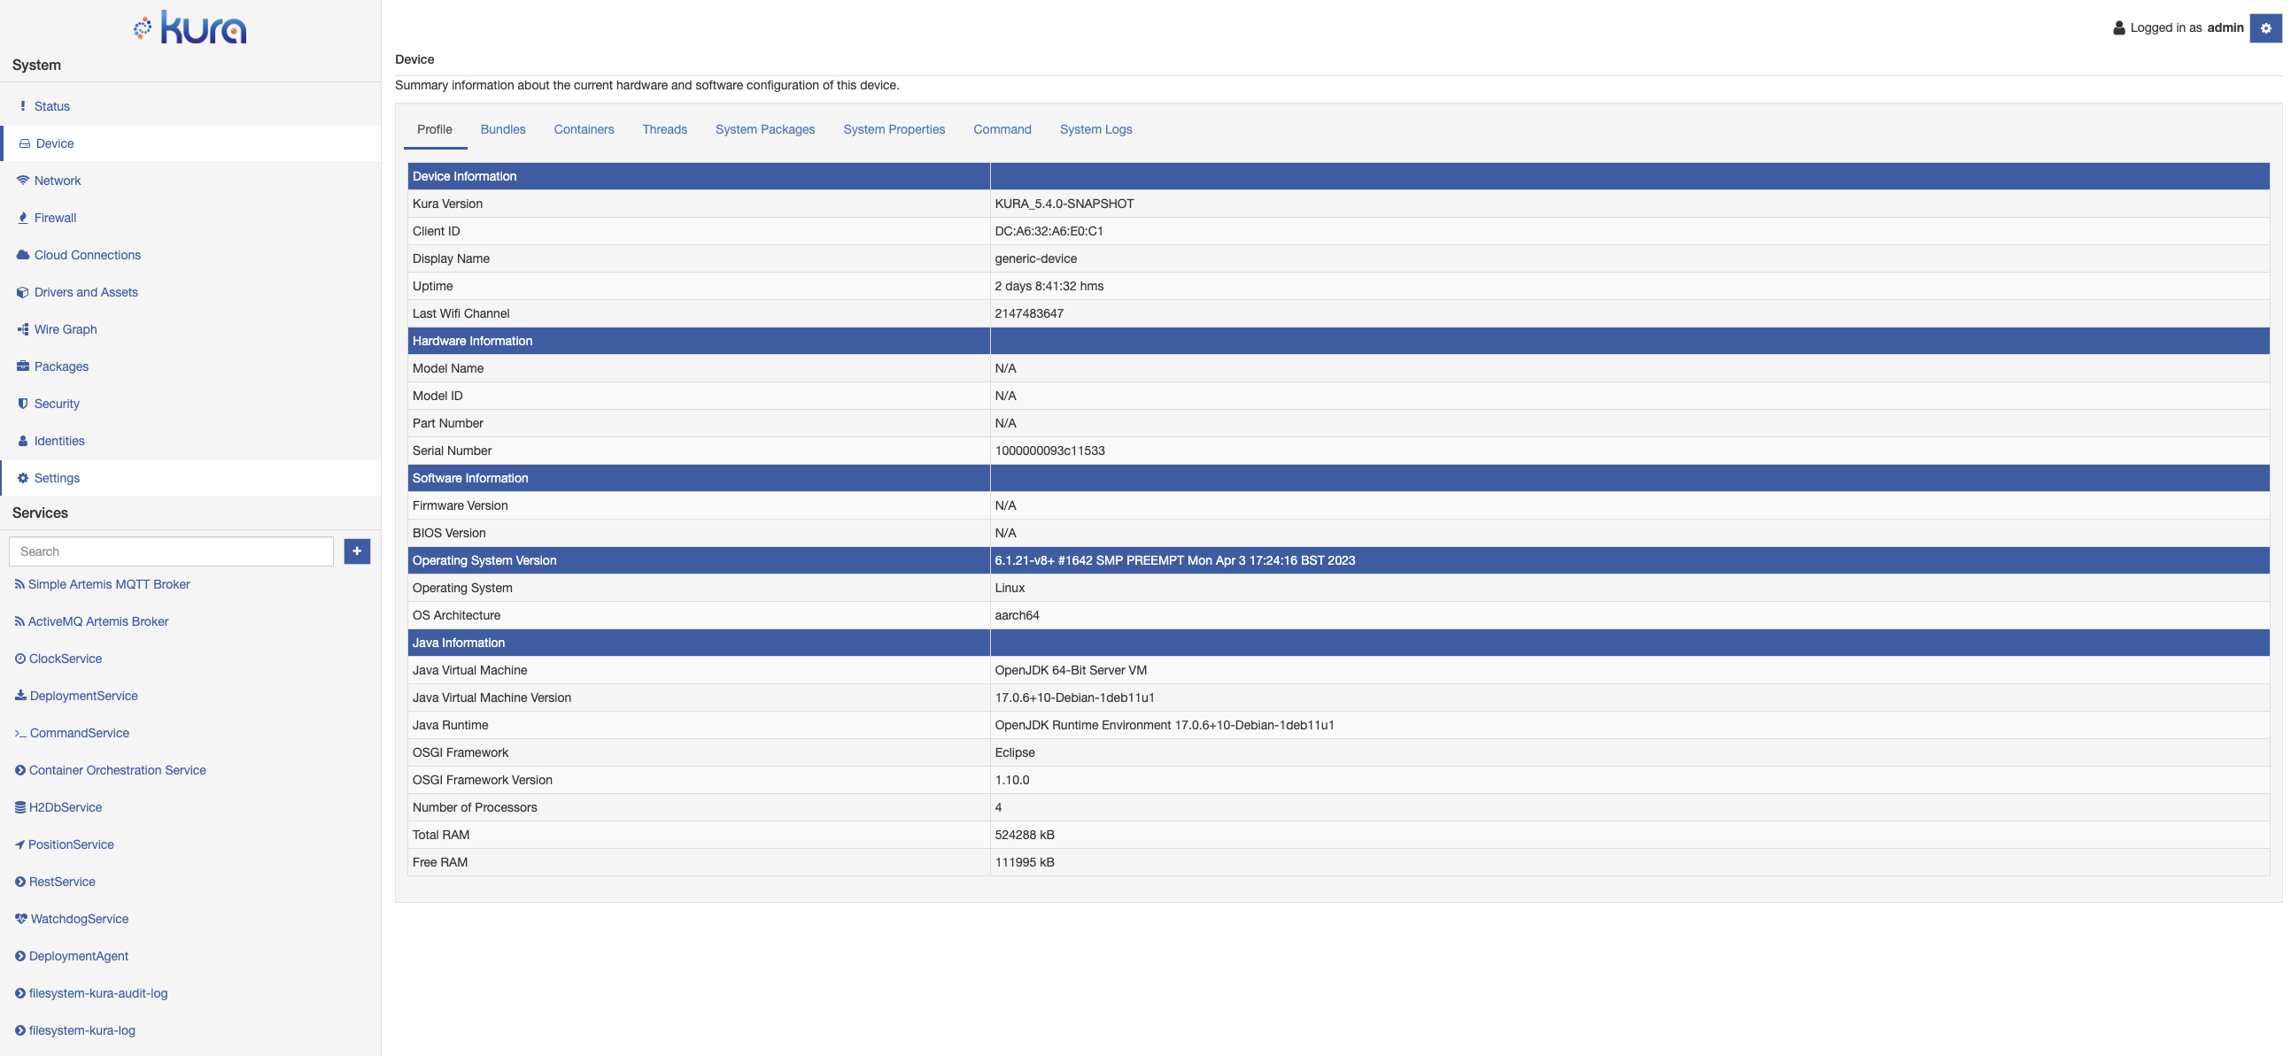

Slide 9
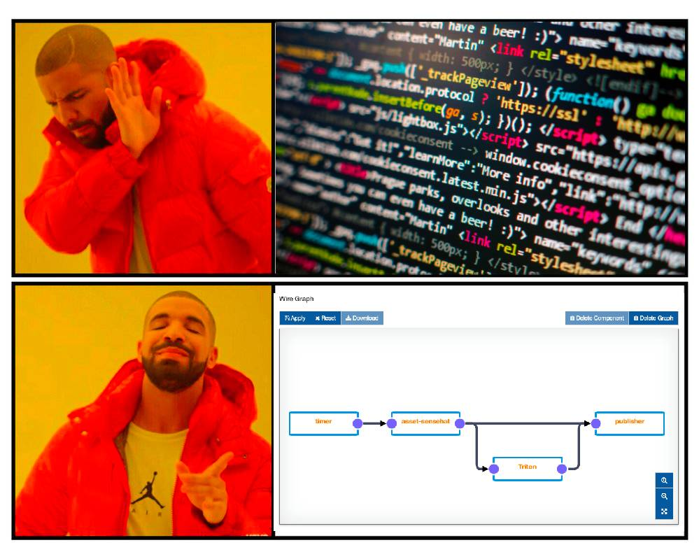
Wire Graph
Data flows and logic, programmed visually
Drag, drop and connect wire-assets to define your business logic
Simplify Development
Never forget what your code is doing
Notes:
Wire graph makes it Easier

Slide 10
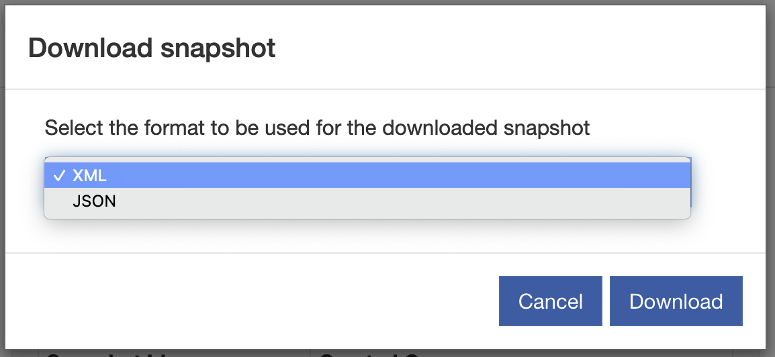
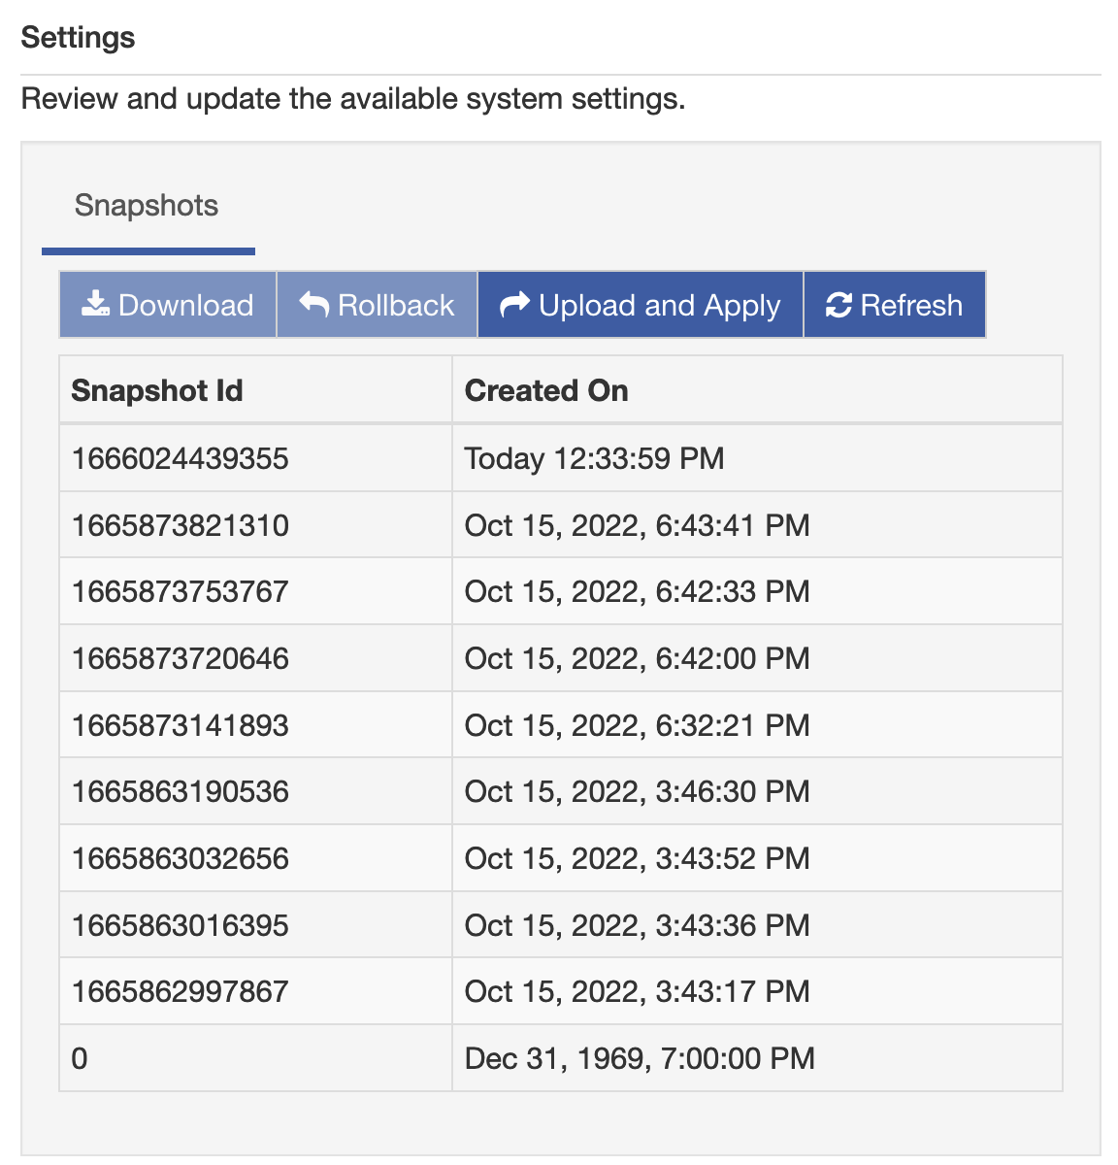
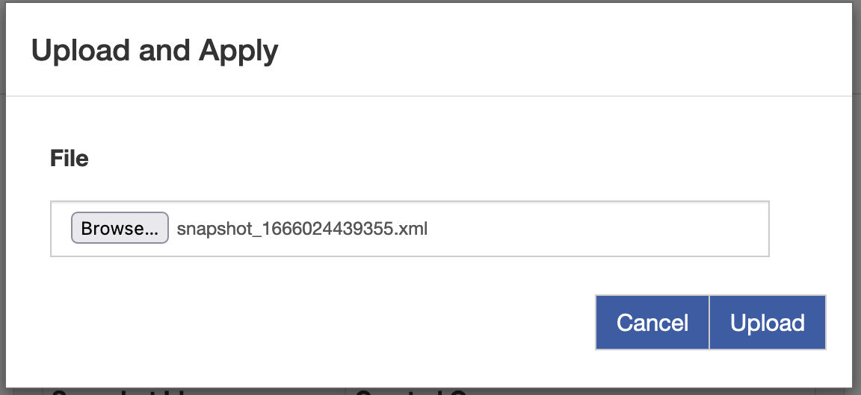
Kura – Snapshots

Slide 11
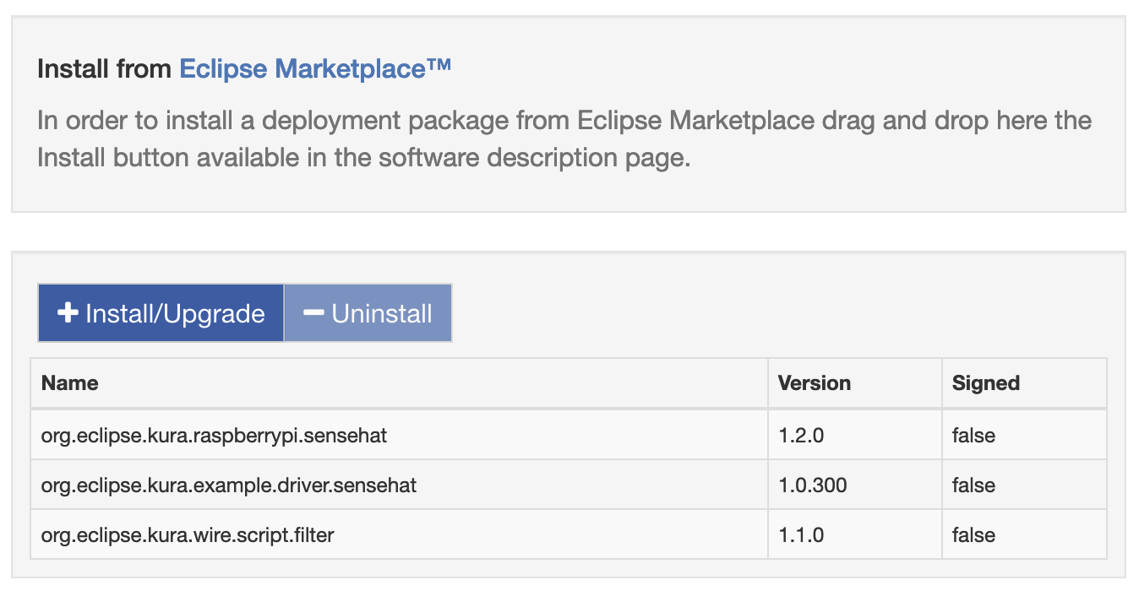
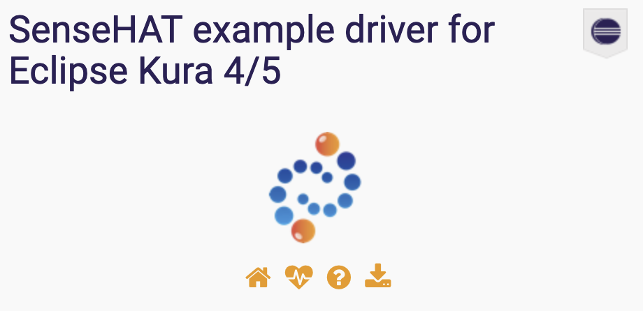
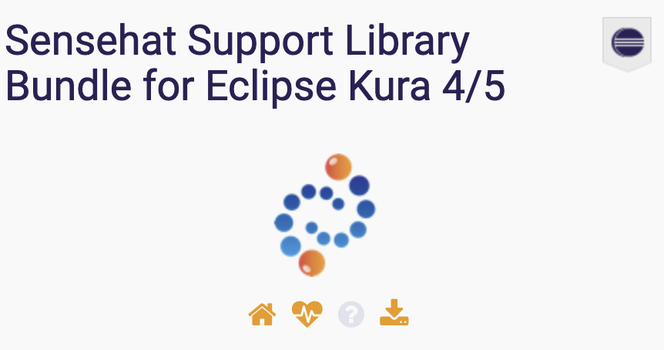


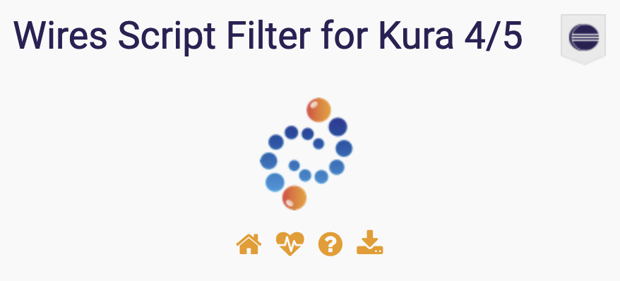
Open Source & Extendible

Slide 12
What Eclipse Kura & Eclipse Kapua look like in a deployment

Slide 13

What is Eclipse Kapua?
Holistic and fully featured Approach to the Edge.
IoT Cloud platform that integrates and manages IoT Gateways
Manages the connectivity of IoT, and Edge gateways
Supports many protocols MQTT, AMQP, and HTTP
Sophisticated multi-tenant account management
Easy data pipelines for collecting mass amounts of information from connected devices
RESTful API for integration with custom applications
intuitive web UI

Slide 14
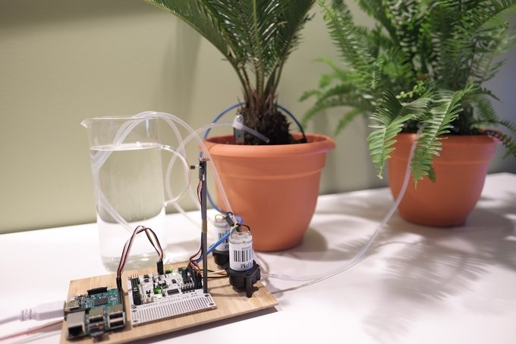
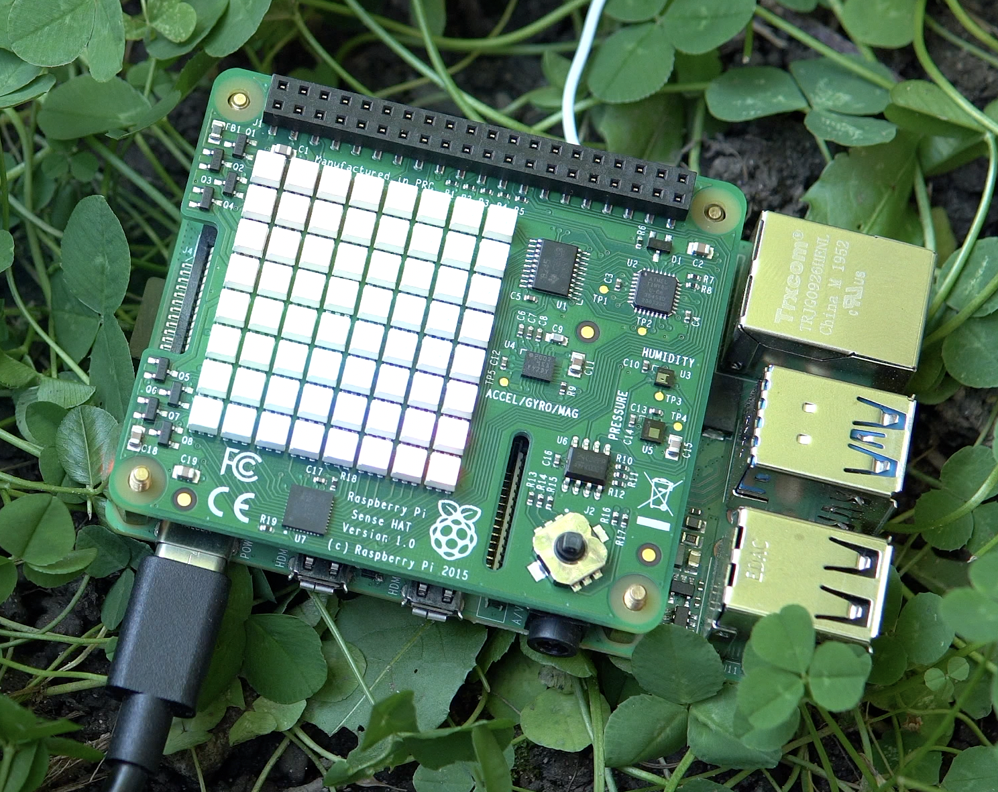
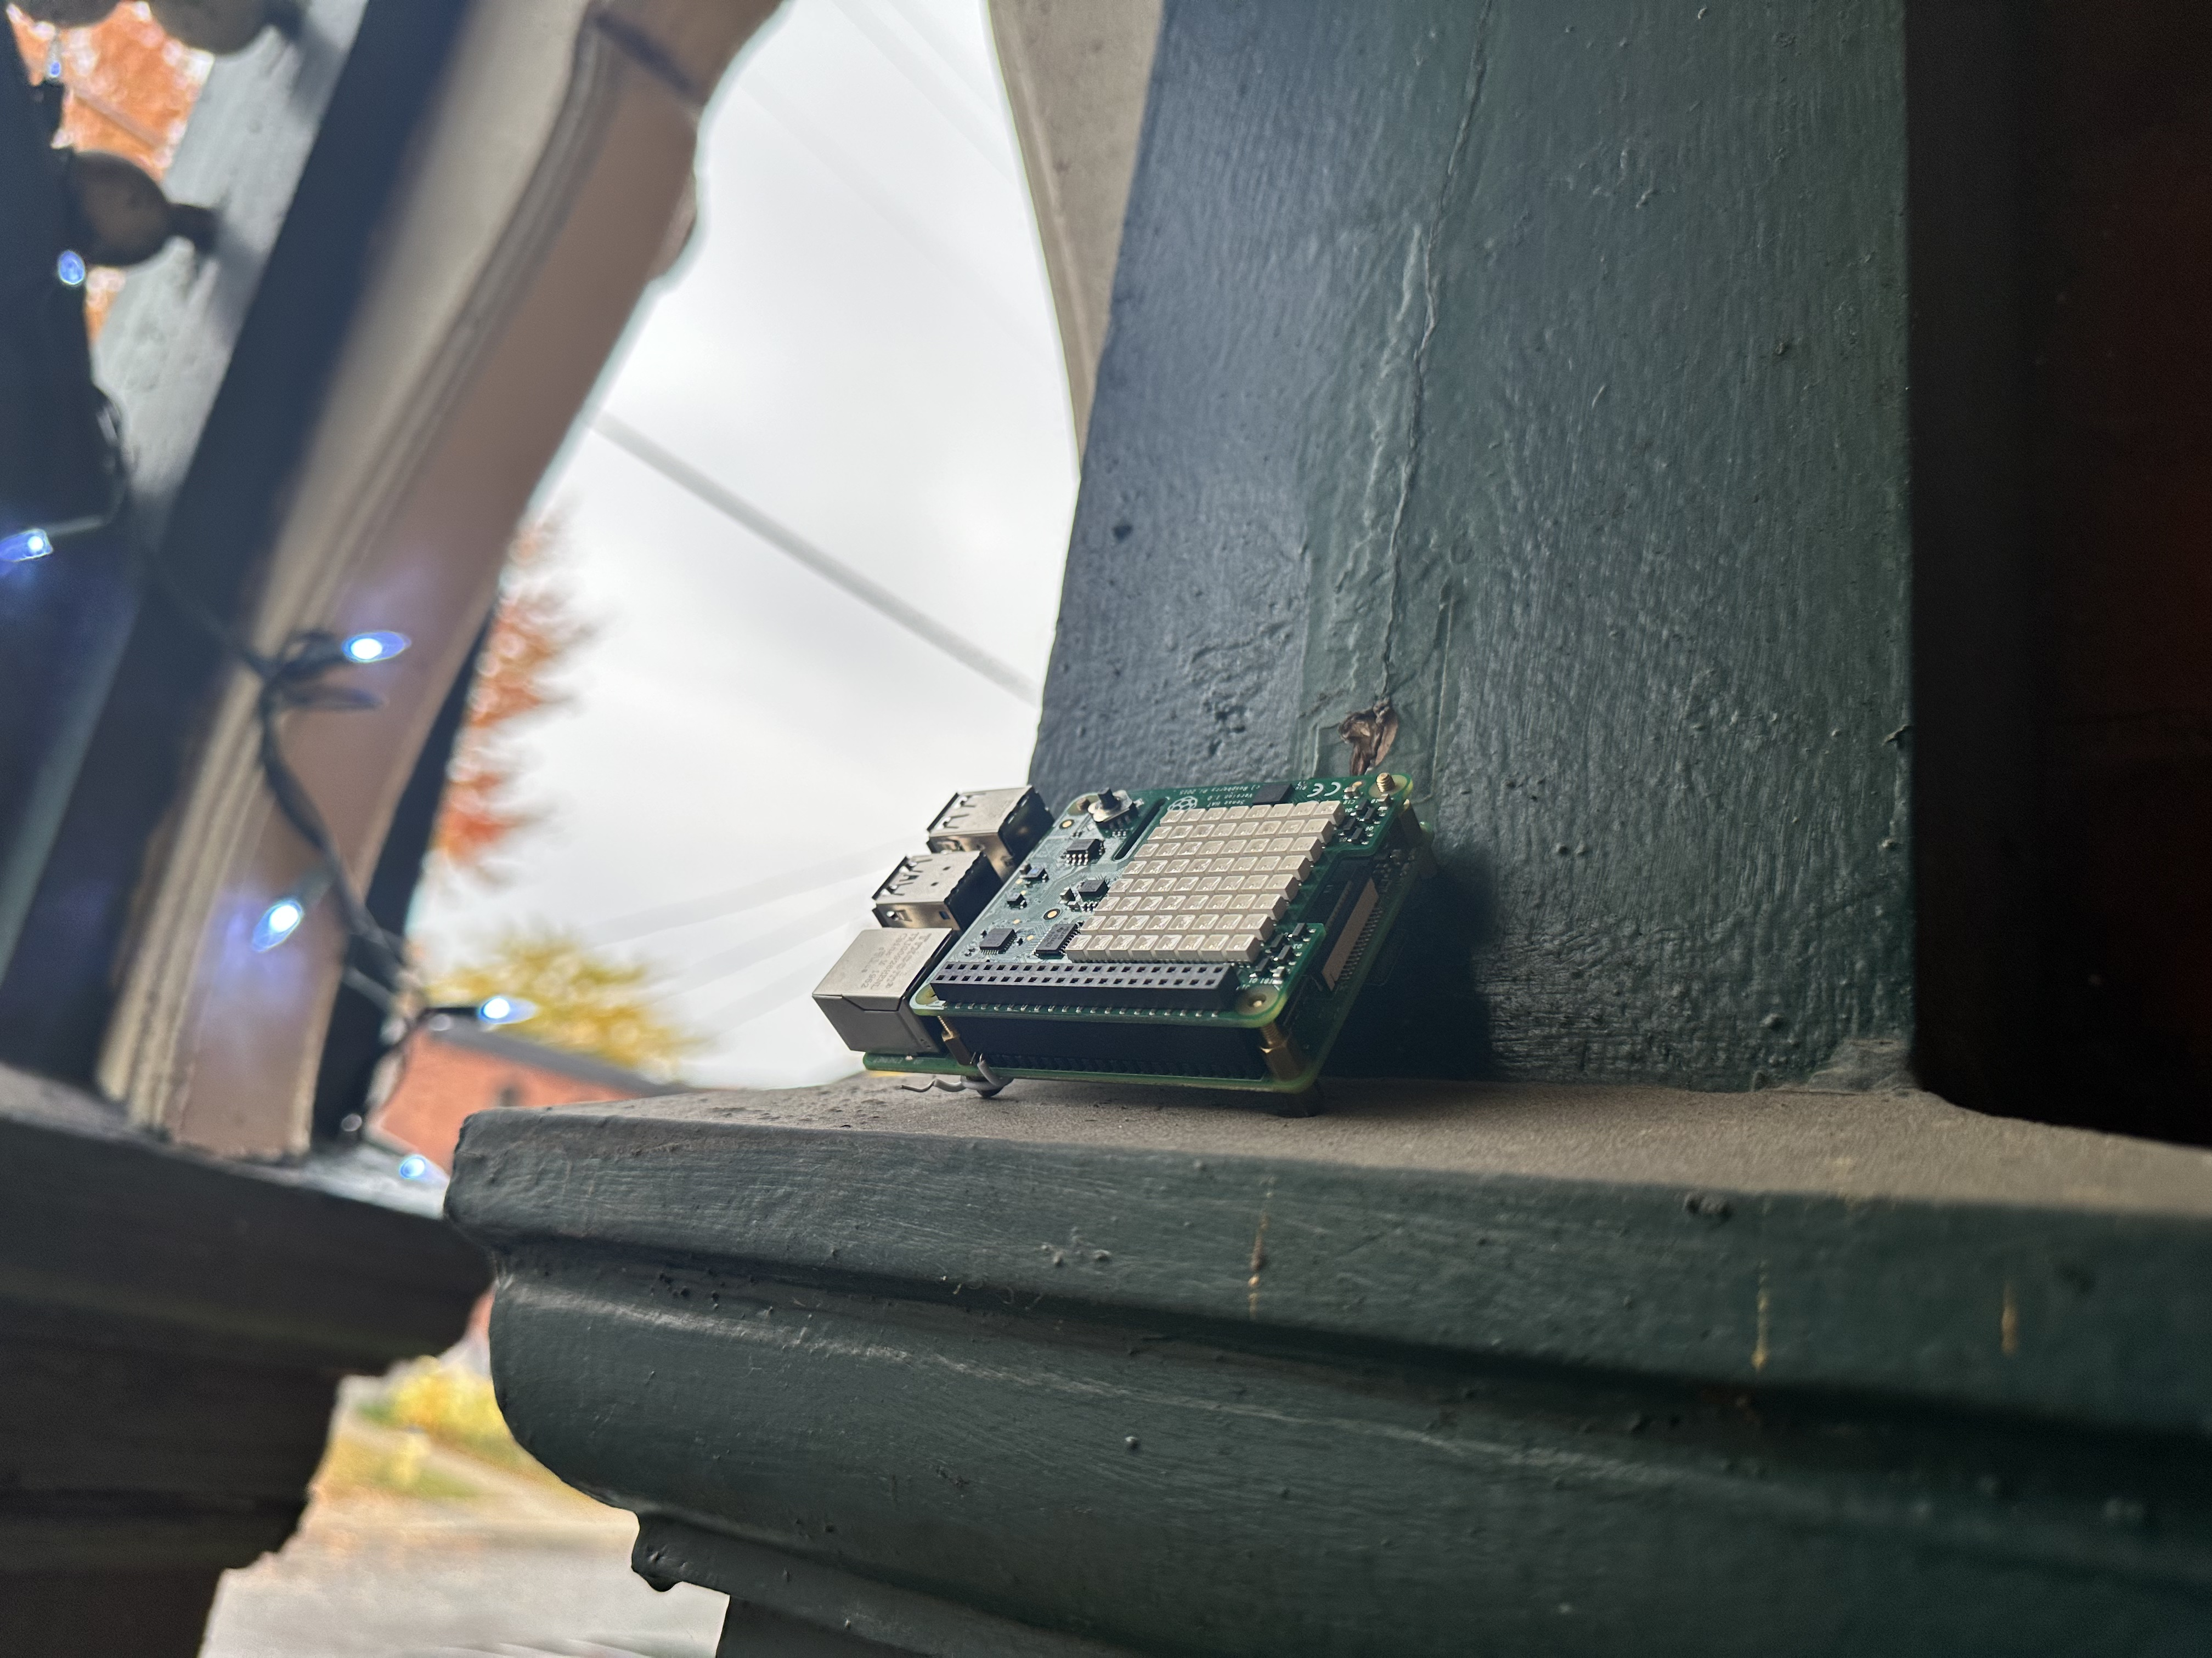
Kapua – Device Connections
Brokered via MQTT
Does not require ports to be opened on the Edge device
Edge devices are expected to not have the best network quality
This Photo by Unknown Author is licensed under CC BY-SA

Slide 15
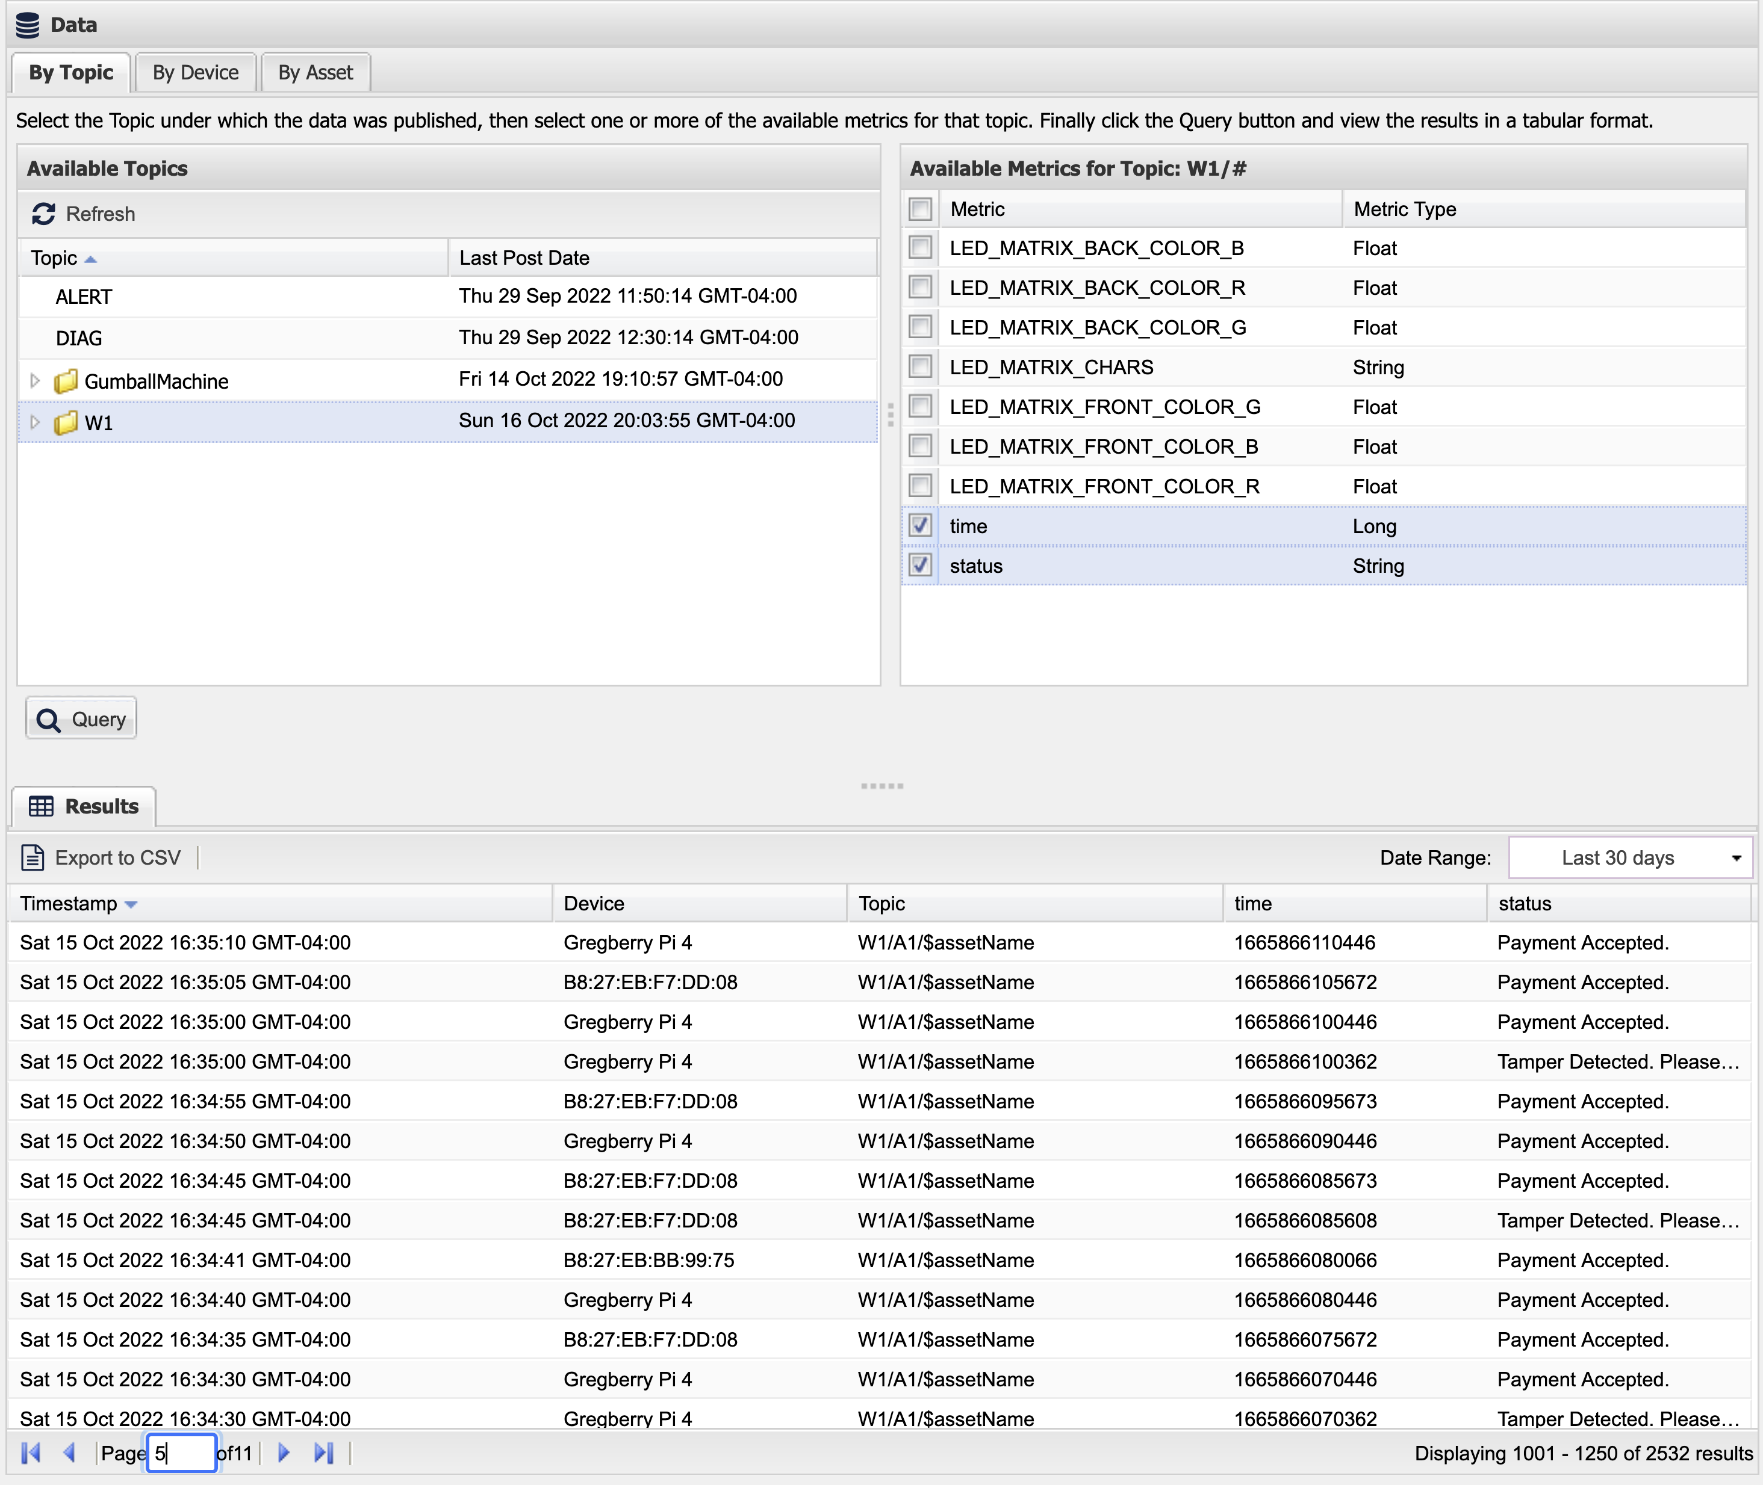
Kapua – Data Aggregation
Data from all of your devices in one place

Slide 16
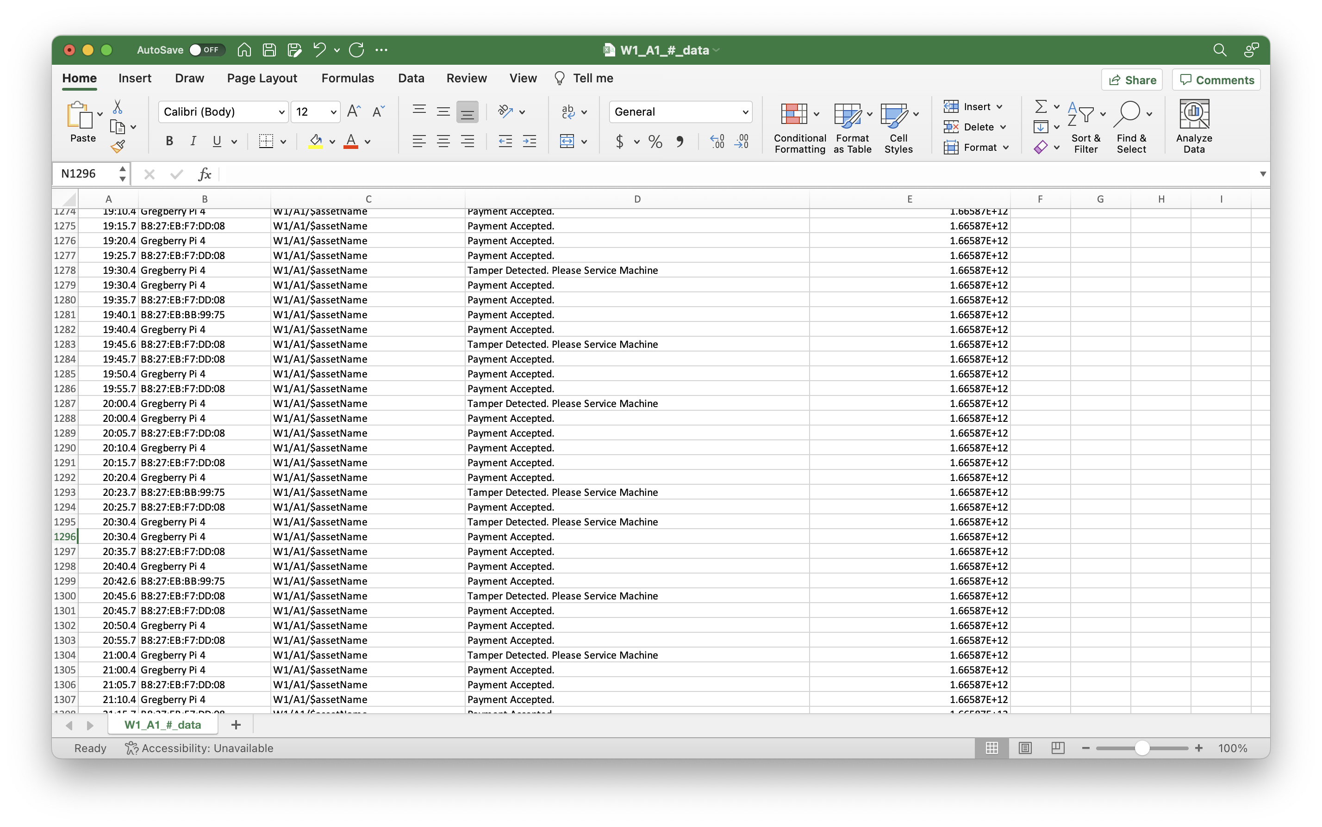
+ REST API’s are Available for data export

Slide 17
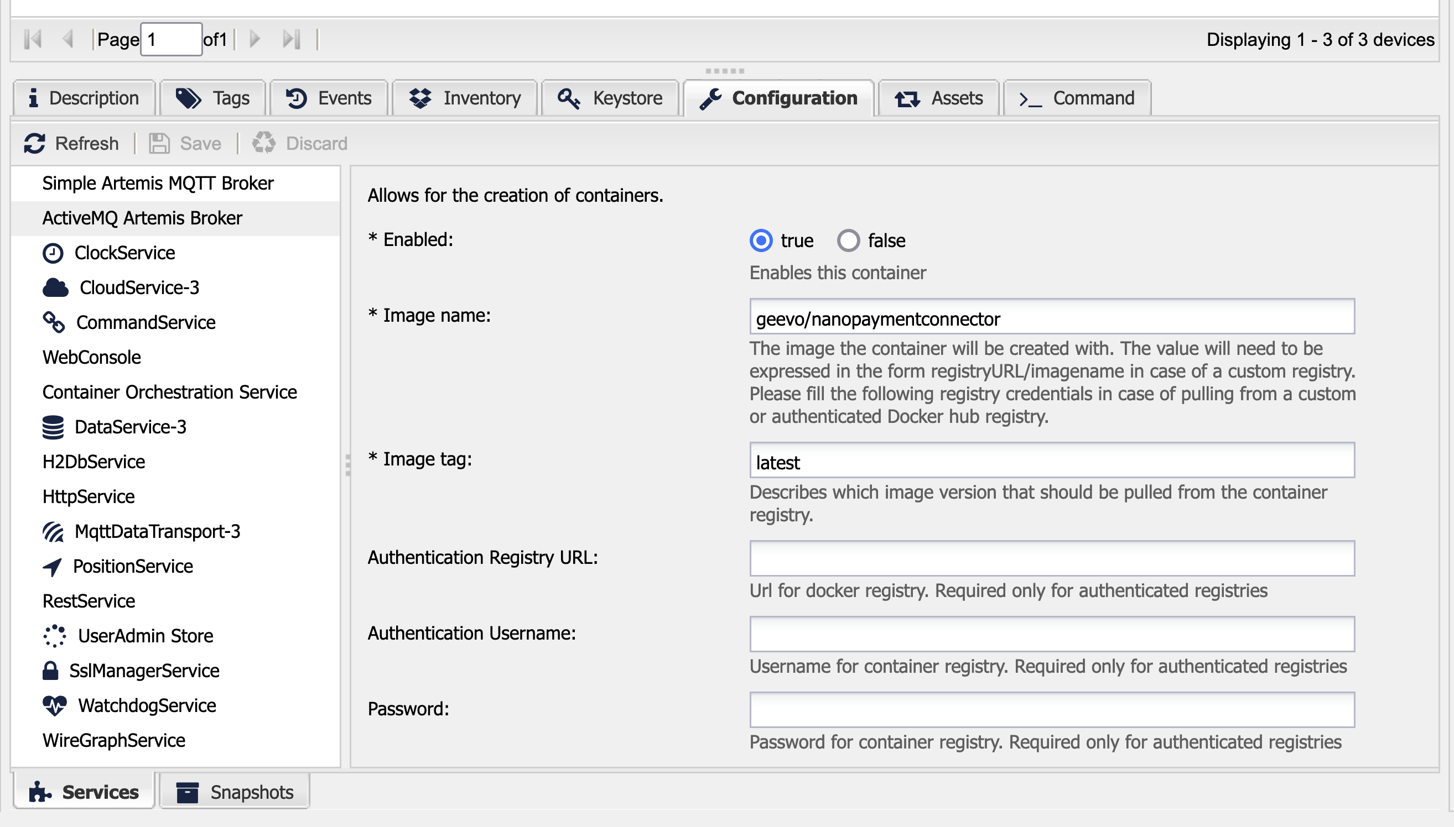
Kapua – Configuration Service
Configure Kura settings from the cloud

Slide 18
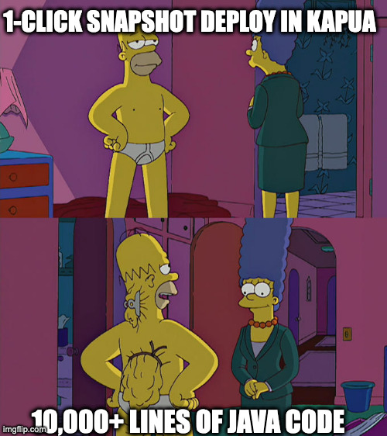
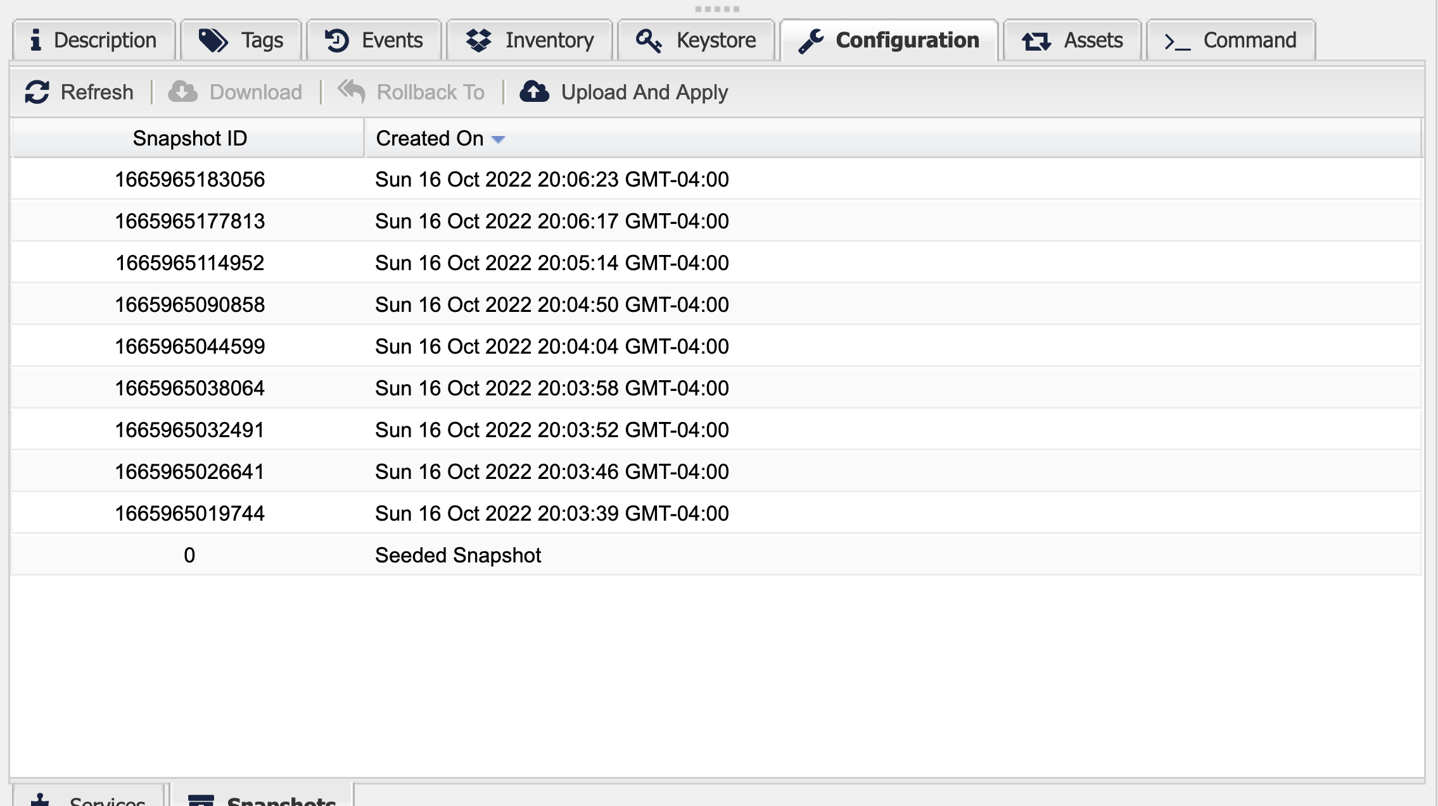
Kapua – Snapshot Service
Scale your deployment by applying snapshots to devices

Slide 19
What Kura & Kapua look like in a deployment

Slide 20
The Future of Edge

Slide 21

Edge Gateways are Getting Powerful
Low Power High Performance CPUs
GPUs
AI acceleration in silicon
HPC’s on the edge …What can you do with this Power?

Slide 22
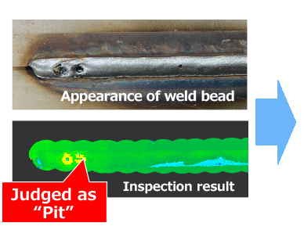
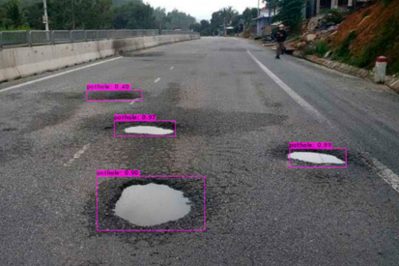
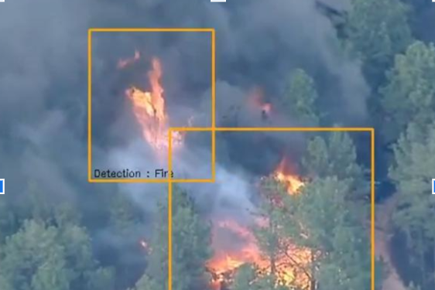
Run AI Workloads on the Edge
Faster response times
Reduce bandwidth
Do the unimaginable with typical cloud-Iot Infrastructure on scale
Notes:
Anomoly Detection

Slide 23
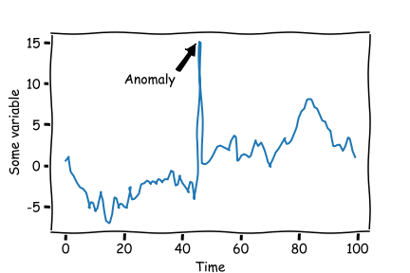
Anomaly Detection
Identifying points of data which fall outside the expected range
Applications
Industry – Part Quality
Business – Fraud detection
Cyber Security – Intrusion Detection
Health Monitoring – ECG Irregularities
[1]
[1] https://github.com/DHI/tsod

Slide 24
Goals
Collect Data using Simulated Edge
Use collected data to Train an Anomaly Detection Model
System Monitoring
Deploy your model to your edge, and Detect Anomalies in the Field

Slide 25
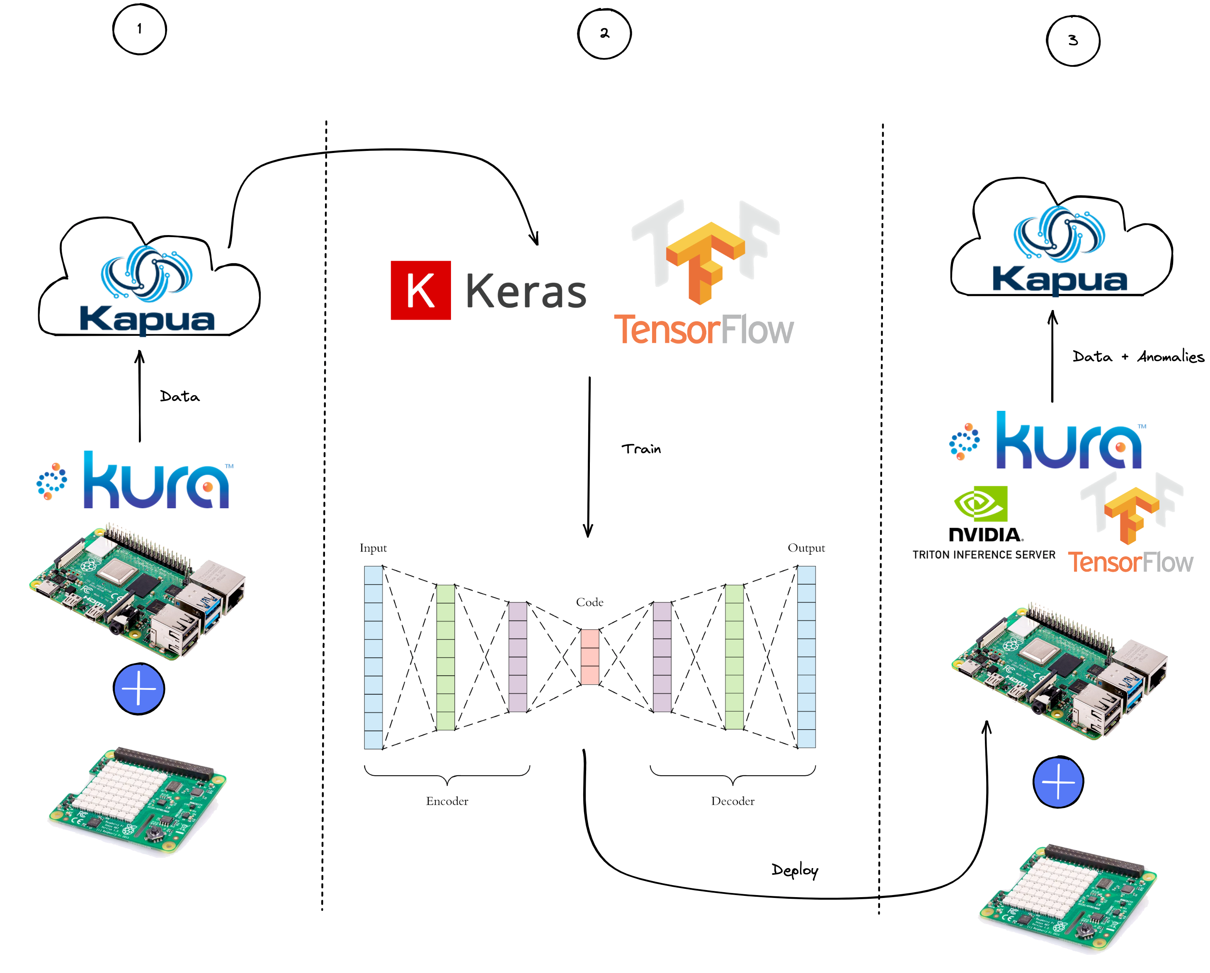
The Game Plan
Setup Kura
Connect Kura to Kapua
Data Collection
AI model building and training
Deploy your AI model on the edge

Slide 26
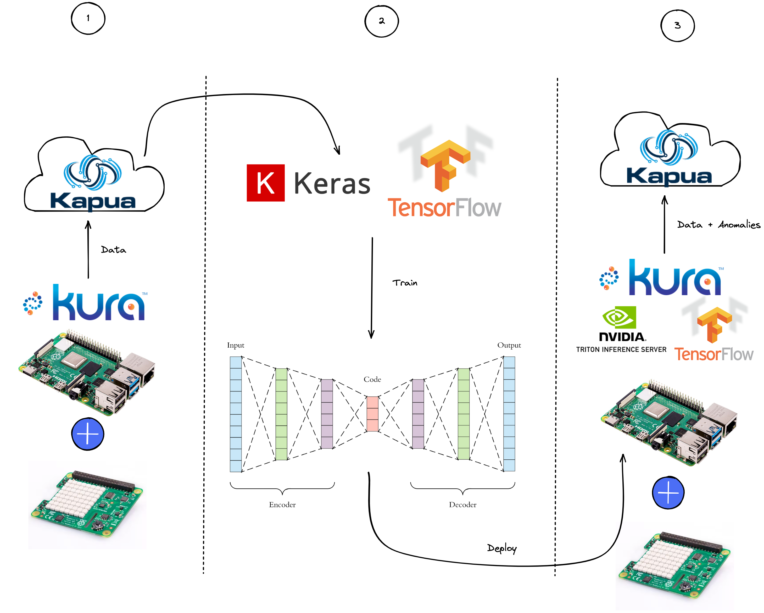

The Game Plan

Slide 27
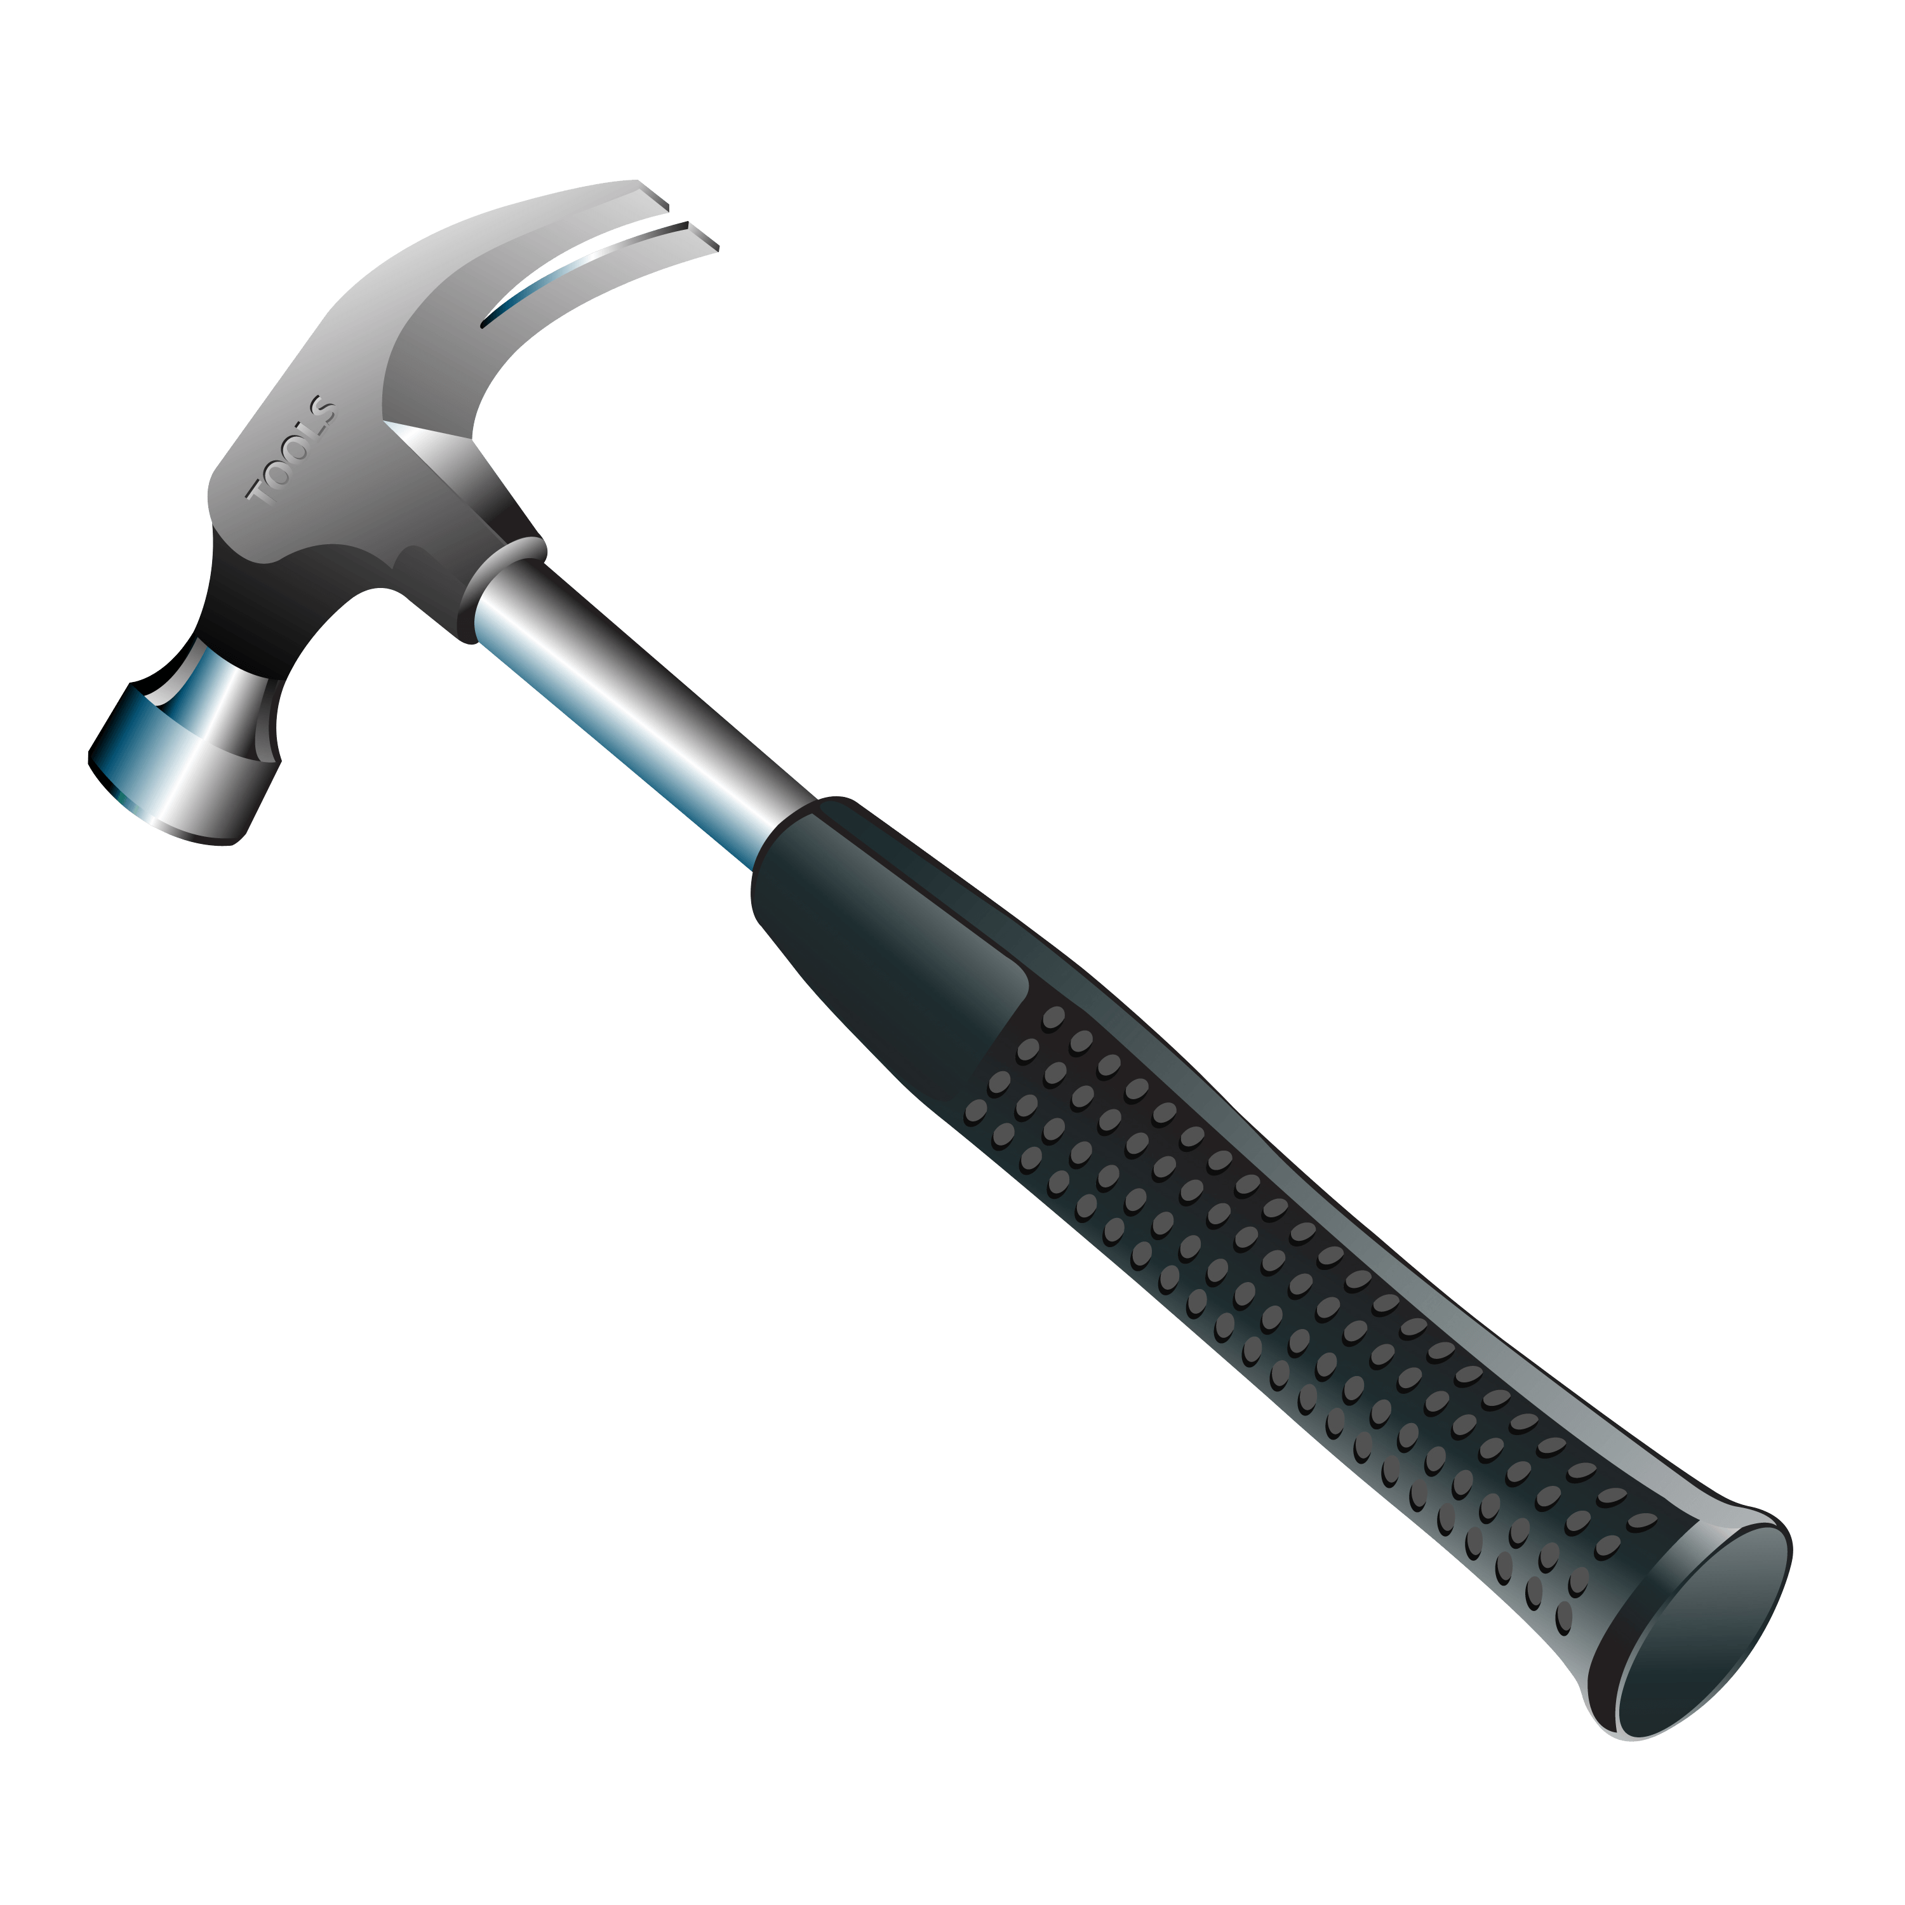
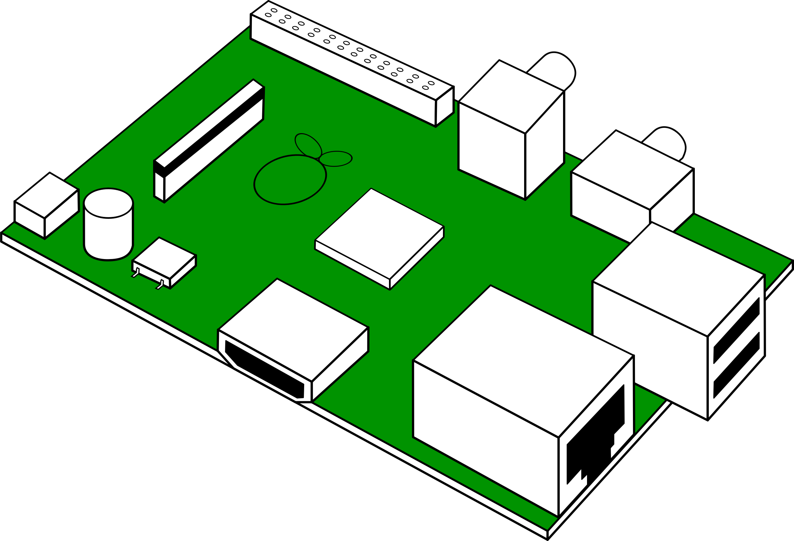
Todays Demo
Setup Kura
Connect Kura to Kapua
Data Collection
AI model building and training
Deploy your AI model on the edge
This Photo by Unknown Author is licensed under CC BY-NC

Slide 28

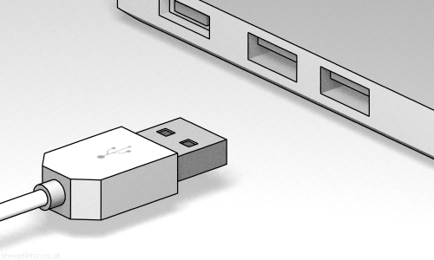
How to get started with today’s tutorial
Download the demo via the following URL
Plug in the provided USB stick
OR
https://qrco.de/beQ6TT
Then, Follow the instructions in Setup.md file

Slide 29
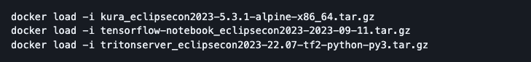
Setup Kura
Load the three archives containing the docker containers required for this tutorial with the following commands:
Run the following command to start:
Verify the containers are running:

Slide 30
Setup Kura – Cont.
Eclipse Kura™: https://localhost
Credentials: admin/admin
Jupyter Nokebook: http://localhost:8888/lab?token=`token-id`
Credentials: the token-id noted earlier
Nvidia™ Triton: localhost:4000-4002 (no web fronted)
Eclipse Kapua™: https://eclipsecon2023-kapua.dev.everyware.io
Account: eclipsecon2023
Credentials: Check on card you received
MQTT port: 1883

Slide 31
Questions?
31

Slide 32


scan qr code
get your gadget* at Eurotech booth #06
fill out our form
* limited supply

Slide 33


Thank you!
Join the conversation:
@EclipseCon | #EclipseCon

Slide 34


Check us out on GitHub

Slide 35
Evaluate the Sessions
Please help by leaving feedback on the sessions you attend!
To rate a session, you must be registered for it in Swapcard BEFORE the talk starts.
Swapcard will prompt you to leave feedback after the end of each session.
You may also rate a talk by locating the session from the “Agenda” or “My Event” buttons on the Swapcard Event Home page. Click on the session and look for the “Give your feedback” box.

